Slide 1
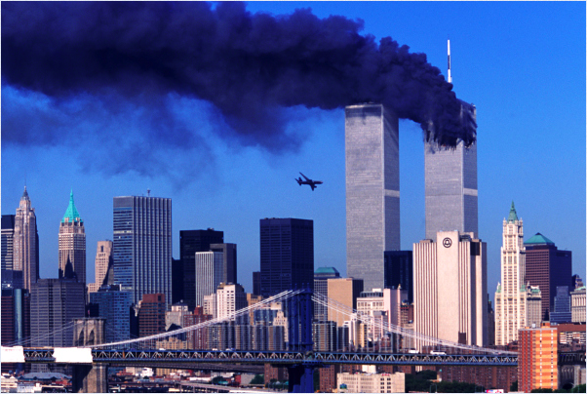
9/11
A Tribute

Slide 3
Video:
https://www.youtube.com/watch?v=g11nNUqMcro

